Slide 1
TuDu!
Brian Quezada
@Briantpt30

Slide 2
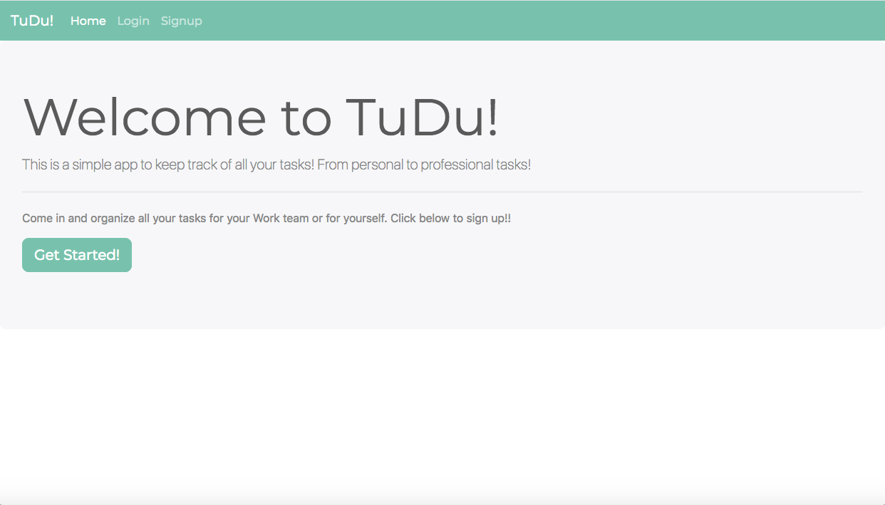
Description
An 1-3 sentence elevator pitch version of your project description. What problem does it solve?

Slide 3

Features
Login
Create Projects
Create Groups
Add Comments
Create Tasks

Slide 4

Planning - User Stories
User can Create a project and create tasks for the project.
User can Create group and manage projects and tasks for a group of users.
User can add comments to tasks for more detailed work to be done.

Slide 5

Planning - Database
User- Contains all user information
Group- Contains group name and list of users
Project- Contains group and user projects with list of tasks
Task- Contains task title and description, list of todos and comments
Todos- Contanins todos for each task.
Comments-Contains comments for each task

Slide 6









Technology Stack
Java
JavaScript
JPA/Hibernate
SpringBoot
Spring Security
MySQL
Html
Css
ThymeLeaf

Slide 7
Demo

Slide 8

What I Learned
Spring Security
JavaScript
ThymeLeaf- How to do Model binding
Bootstrap – Using progress bars and different types of forms
Css- Moving objects

Slide 9
What’s Next
Add functionality to mark a task complete
Assign a task to a user
User Profile page
Throw Java away
Throw my Mac away
Maybe snazzing up the UI
Notes:
Be specific! If you mention another feature describe why that features is necessary, or what problem it solves. If you mention changing the UI mention specific technologies, or libraries you will use to do that. If you mention a technology, or feature you don’t know yet tell them how you plan on learning it.

